Slide 1
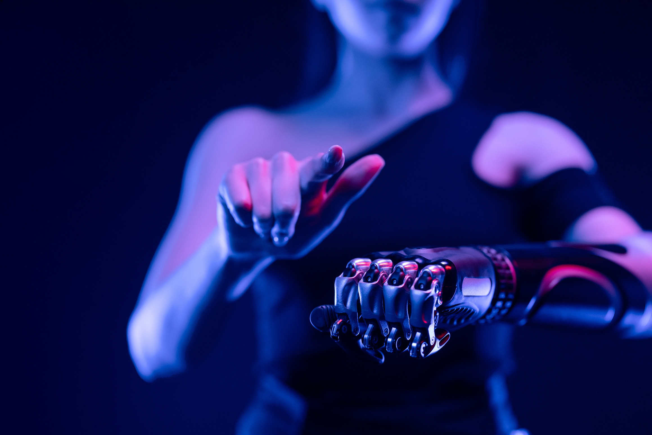


SHIVAJIRAO S. JONDHALE COLLEGE OF ENGINEERING
Department of Artificial Intelligence and Machine learning
Face ID Attendance System
Team members
Our Mentor
1.Sakshi Tiwari
2.Vaishnavi More
3.Sakshi Dalvi
Prof. Anita Shirture

Slide 2
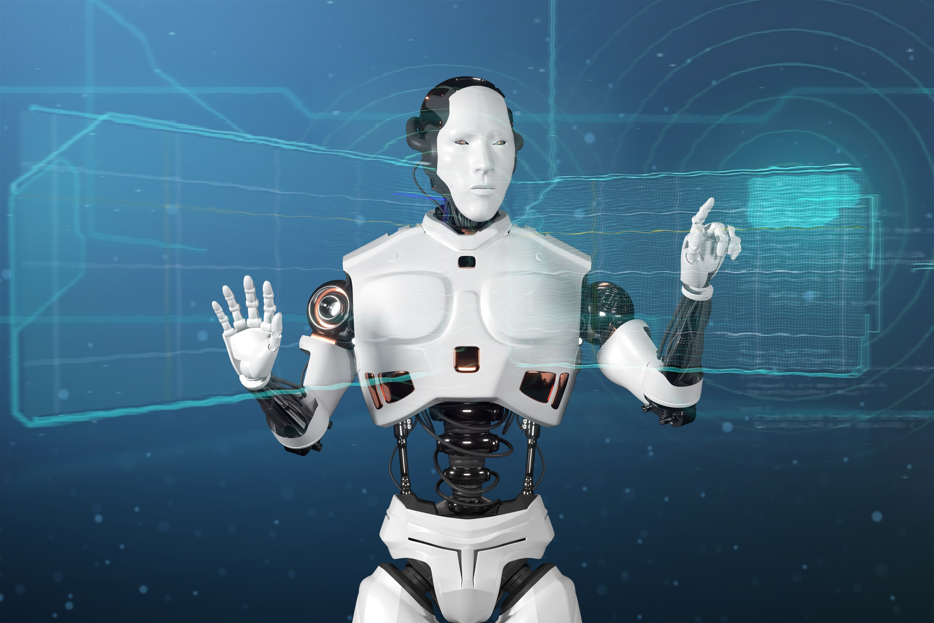

Introduction
A Face ID Attendance System is a biometric technology that uses facial recognition to track and record attendance in various settings, such as workplaces, schools, or events. Instead of traditional methods like manual sign-ins or fingerprint scanning, this system leverages advanced facial recognition algorithms to identify and authenticate individuals in real-time by analyzing their unique facial features. It offers increased efficiency, accuracy, and security by eliminating the risk of fraudulent attendance and reducing manual effort, while providing a contactless and user-friendly solution for managing attendance.

Slide 3
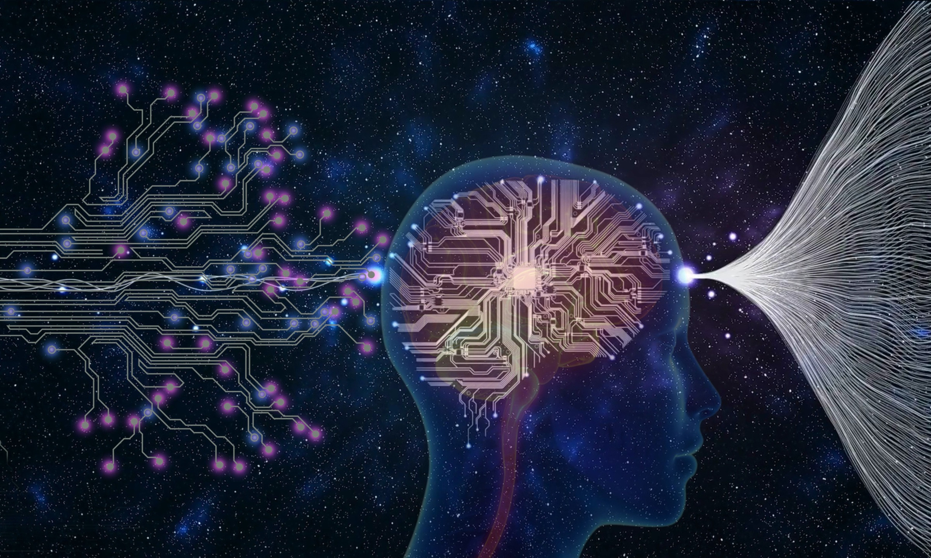
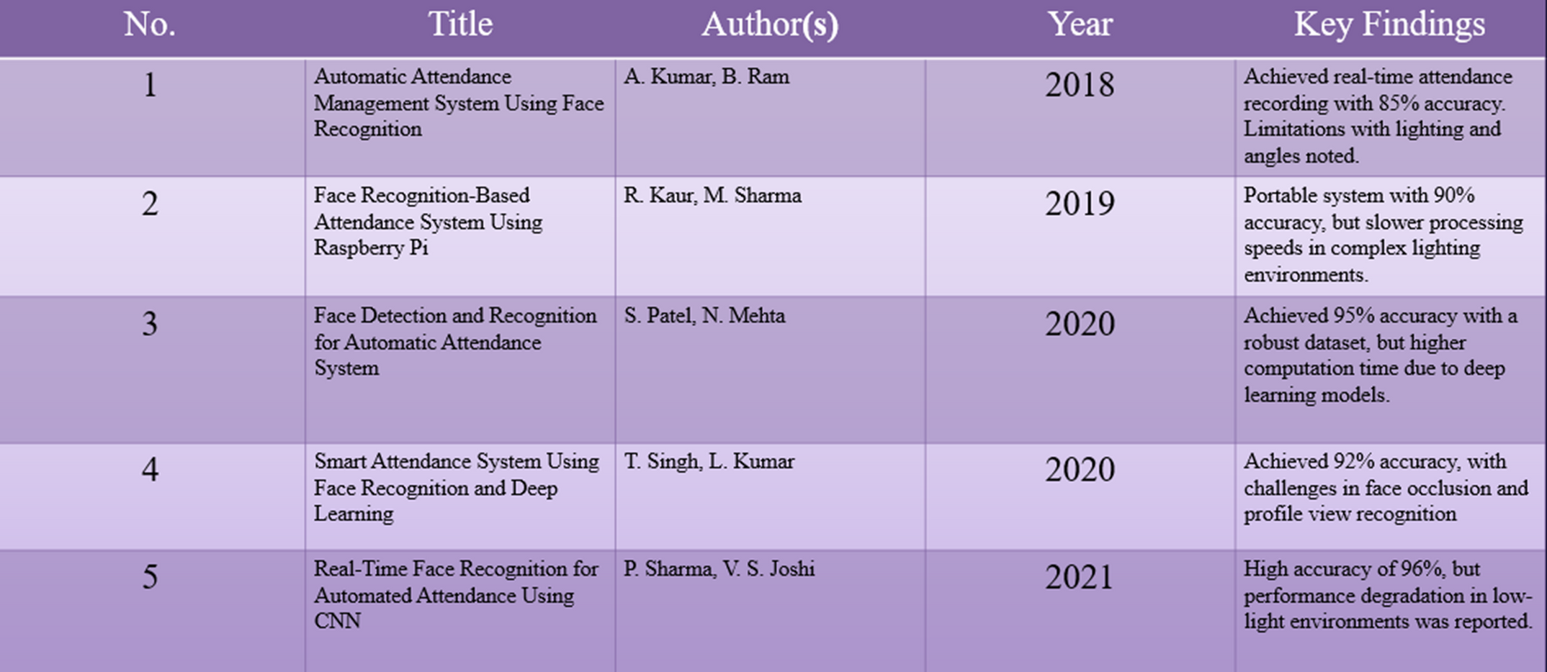
Literature Survey

Slide 4

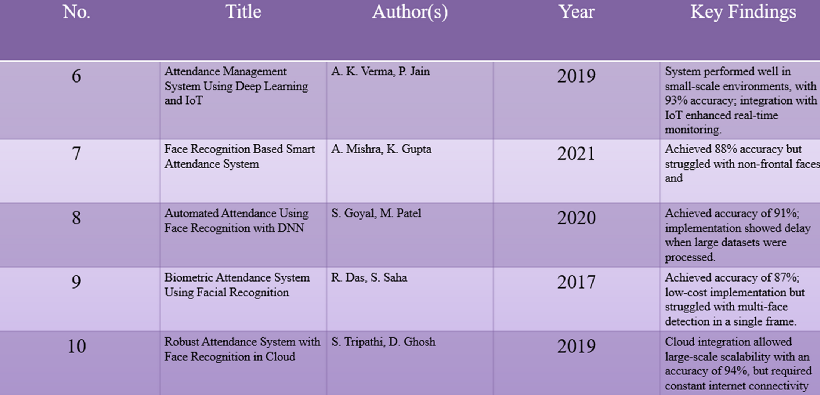

Slide 5
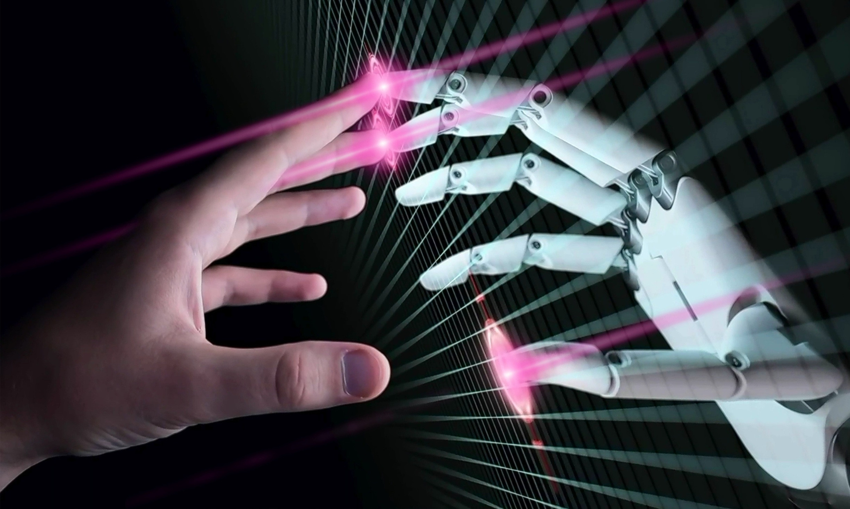
Problem Statement
In traditional academic and organizational settings, manual attendance tracking methods are often time consuming, error-prone, and susceptible to various inefficiencies. The existing solutions, such as RFID-based, fingerprint-based, or manual systems, come with their own set of limitations, including intrusiveness, hygiene concerns, and scalability issues. These drawbacks highlight the need for a modernized and efficient attendance tracking system that can overcome these challenges. Furthermore, the ongoing global emphasis on contactless interactions, heightened privacy concerns related to biometric data, and the demand for scalable solutions in diverse environments necessitate a technology-driven transformation in attendance management. The objective is to develop an automated attendance system based on face recognition, leveraging the advancements in computer vision and deep learning, to address the shortcomings of traditional methods.

Slide 6

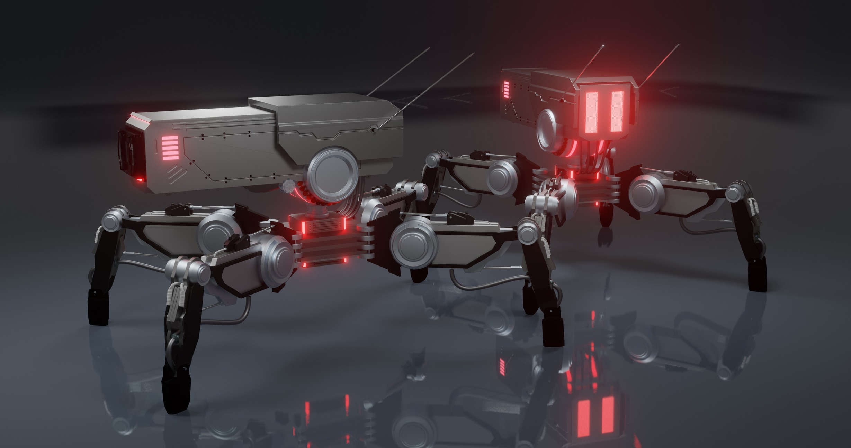
Existing System and its drawback
A Kumar, B Ram (2017) mentioned disadvantages of RFID (Radio Frequency Identification) card system, fingerprint system and iris recognition system. RFID card system is implemented due to its simplicity. However, the user tends to help their friends to check in as long as they have their friend’s ID card. The fingerprint system is indeed effective but not efficient because it takes time for the verification process so the user has to line up and perform the verification one by one. However for face recognition, the human face is always exposed and contain less information compared to iris. Iris recognition system which contains more detail might invade the privacy of the user. Voice recognition is available, but it is less accurate compared to other methods. Hence, face recognition system is suggested to be implemented in the student attendance system.
Limitation: Students can exchange their RFID cards.

Slide 7

Proposed System and it’s merits
Proposed system architecture. Proposed system is Face ID attendance system using face recognition. Face detection has been extensively researched in past few decades. It is a specific case of object detection which determines the size of candidate faces in an image. It is a process of designing a system by giving input consisting of images that contains faces and then training a classifier to identify a face in an image. The main focus of this system is to decrease false positive rate thereby increasing accuracy
Features :- 1. Simple and easy to handle UI
2. Real-Time Face Detection
3. Identification of a Live Person.
4. Support for Multiple Platforms.
5. Ability to Track Attendance Offline
6. No Need of External Webcam to Capture Images.

Slide 8
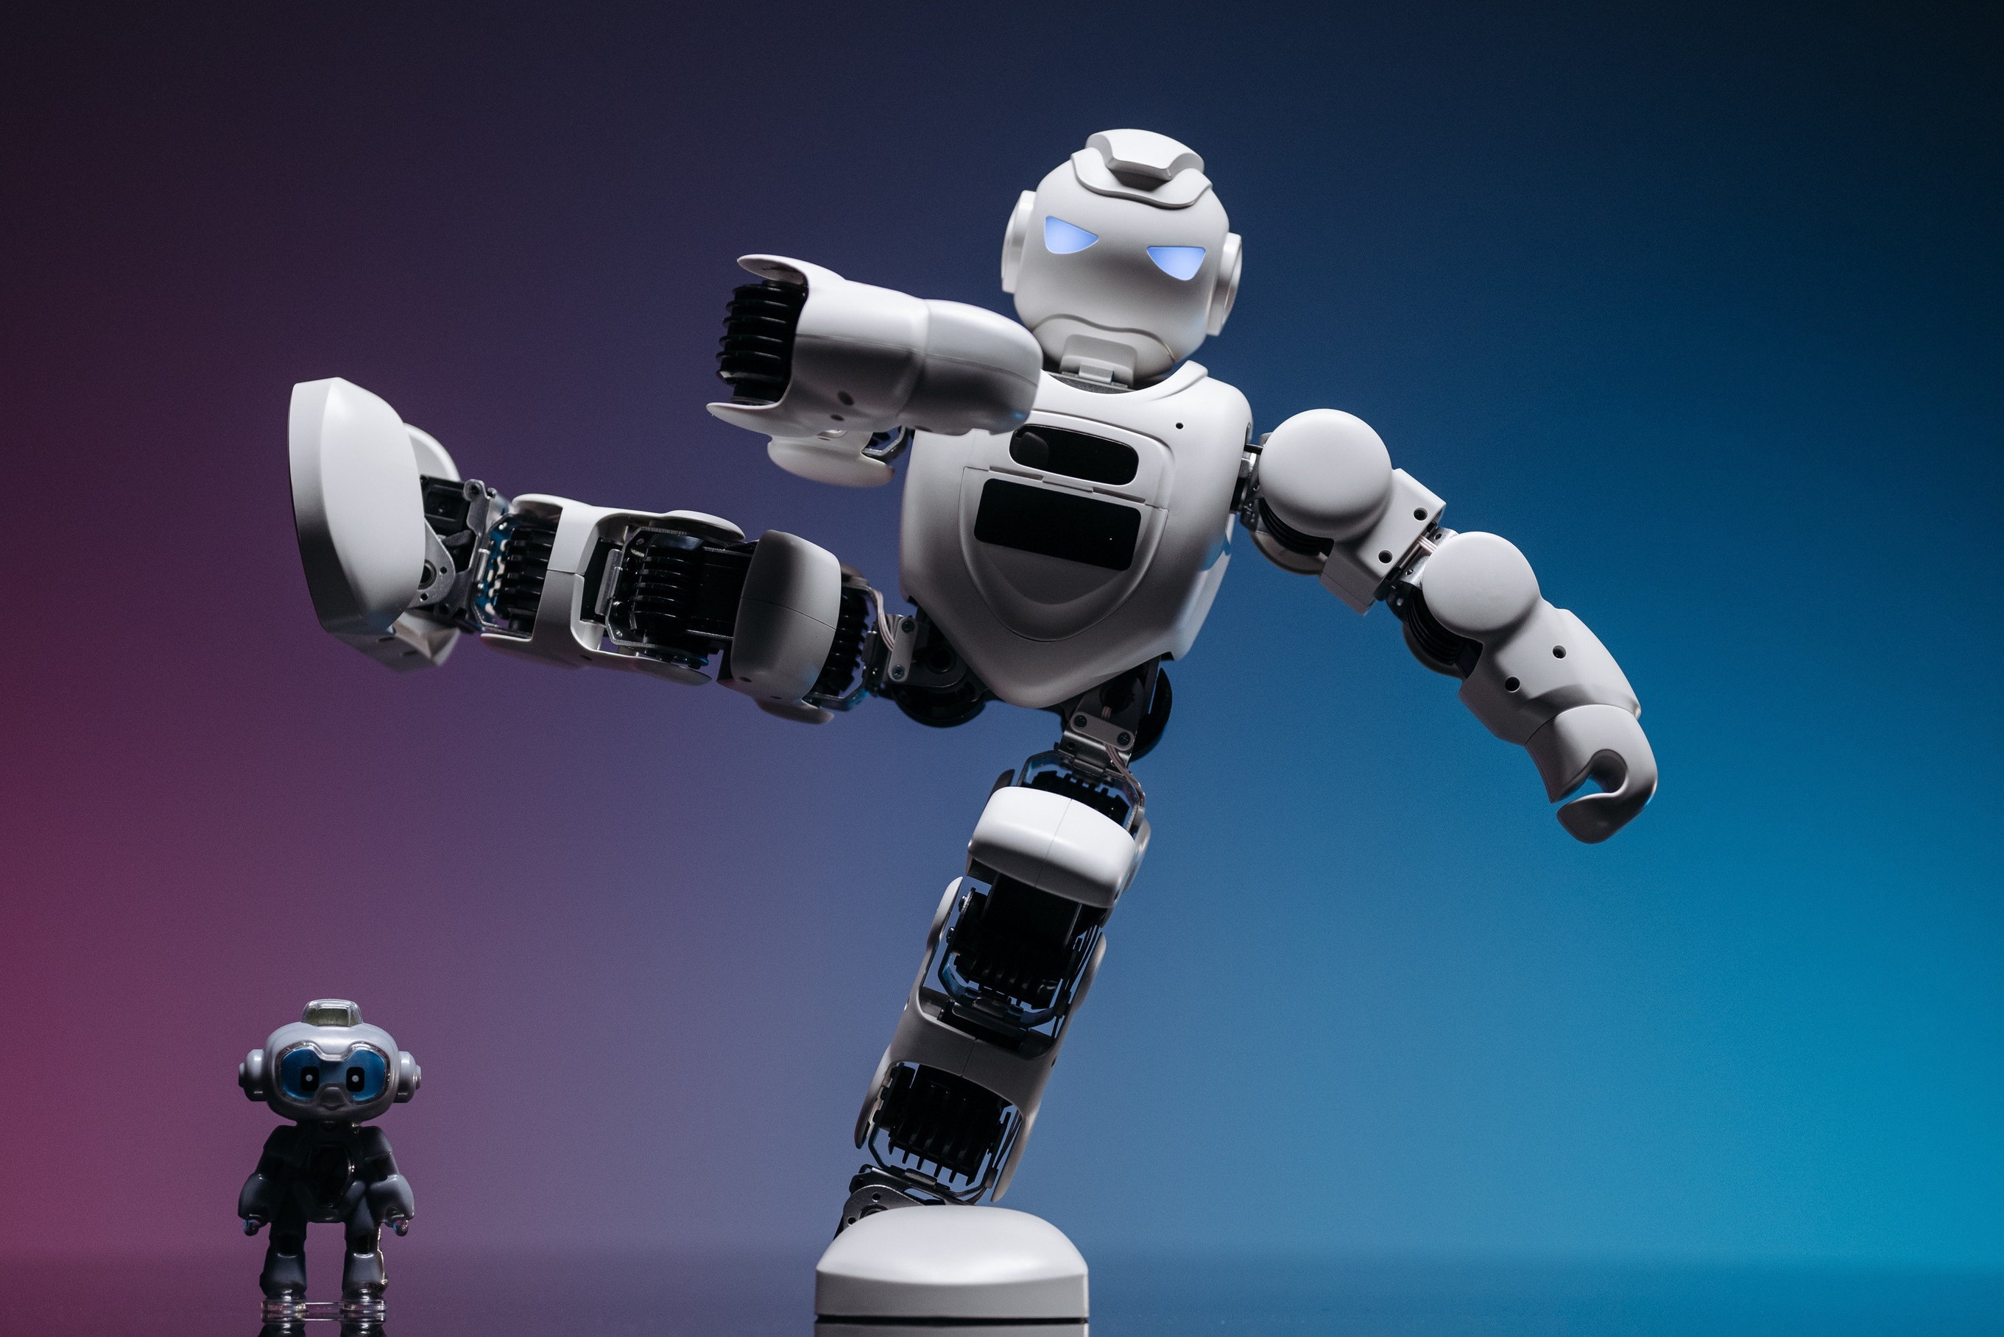

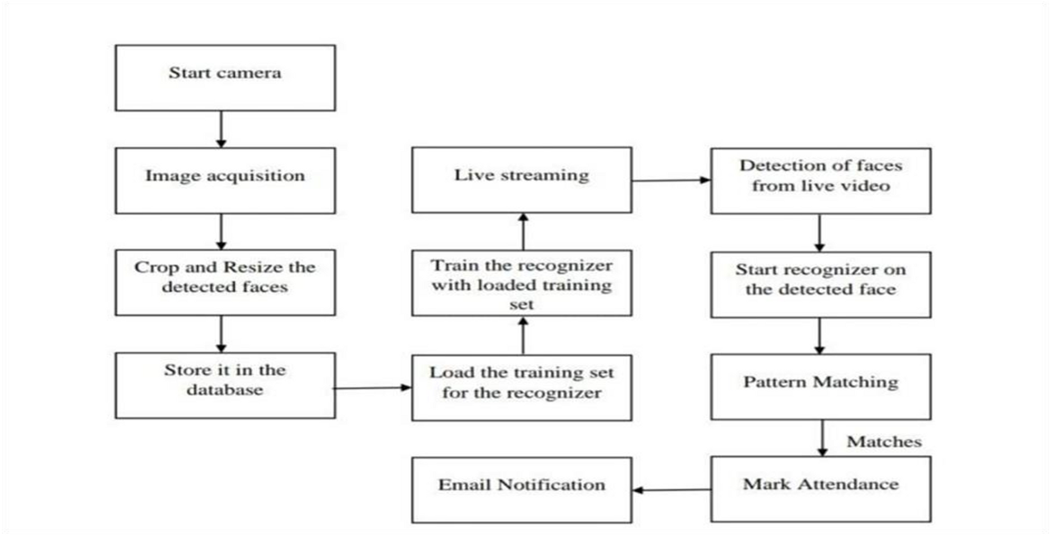






Architectural Framework

Slide 9
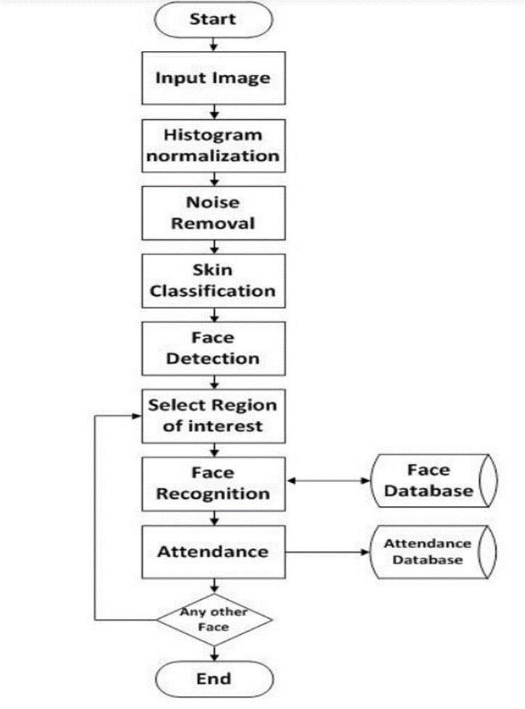
Algorithm

Slide 10
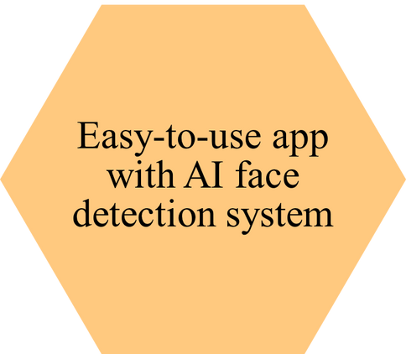
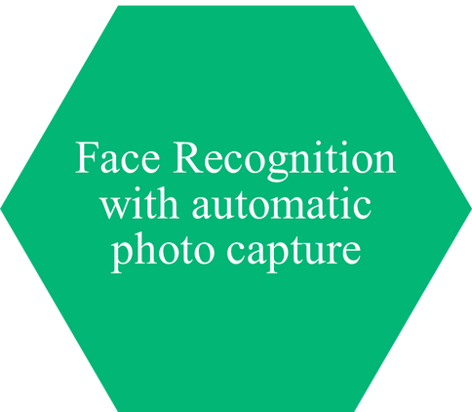
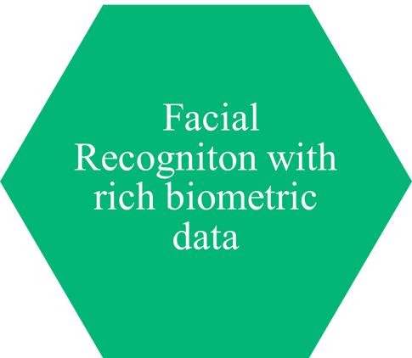
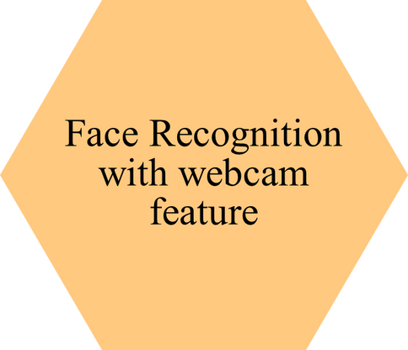
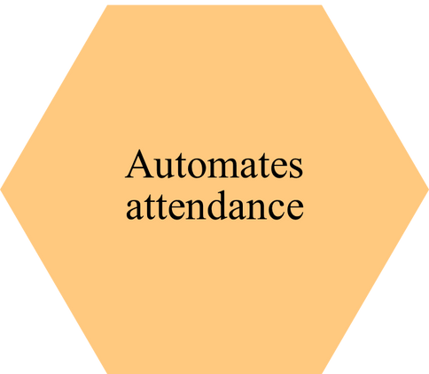

Applications

Slide 11
Hardware & Software Requirements
Hardware :- Computer (i5, 8gb)
Camera
Hard Disk:- 1TB
Software:- Windows 11,
Python Pycharm

Slide 12
Problems Faced During making of Project:
Inconsistent Recognition Due to Pose Variation
Integration with Existing Attendance Systems
Environmental Challenges (Lighting & Background)
Ethical Concerns & Bias in Recognition
OpenCV version variations

Slide 13
Problem Solutions:
Train the system with diverse datasets containing different head angles.
Use common data formats (JSON, CSV) for easy interoperability.
Use infrared (IR) cameras for low-light environments.
Regularly audit the system for bias and retrain with balanced data.
Adding the cascade classifier file.

Slide 14
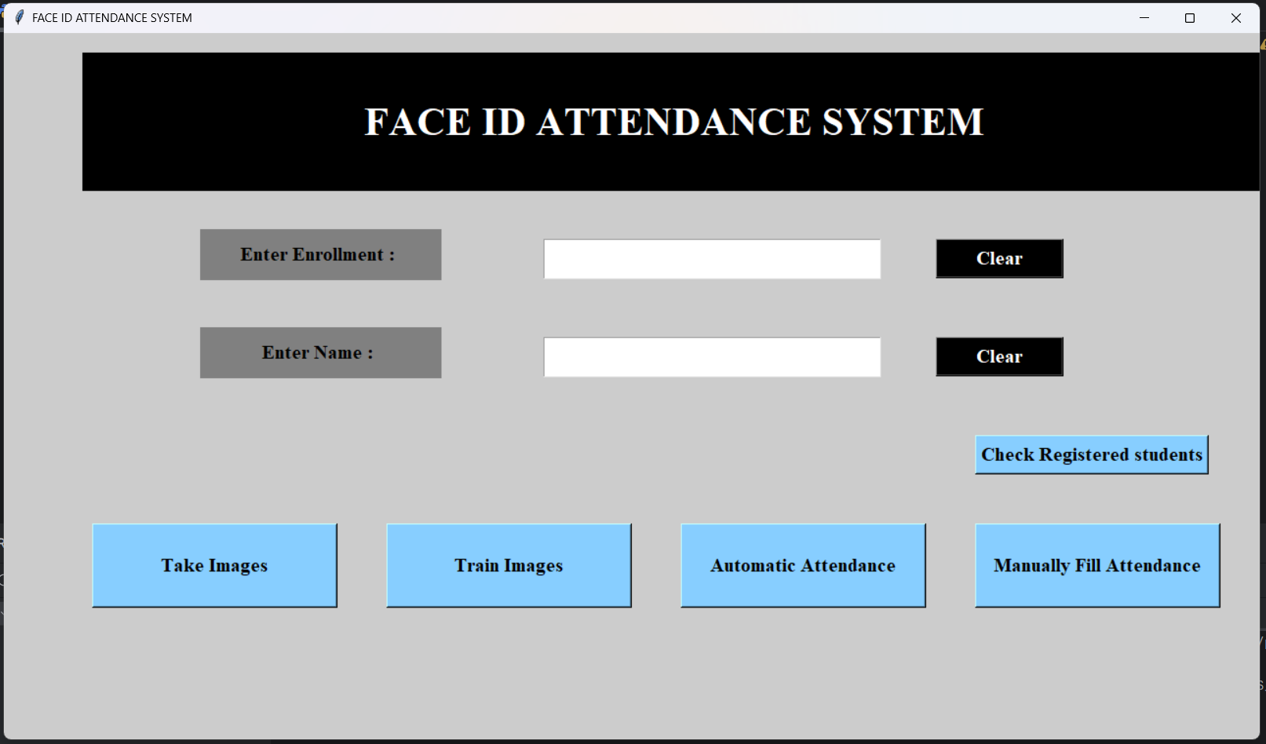

RESULTS
STUDENT DETAILS CHART
MAIN USER INTERFACE

Slide 15

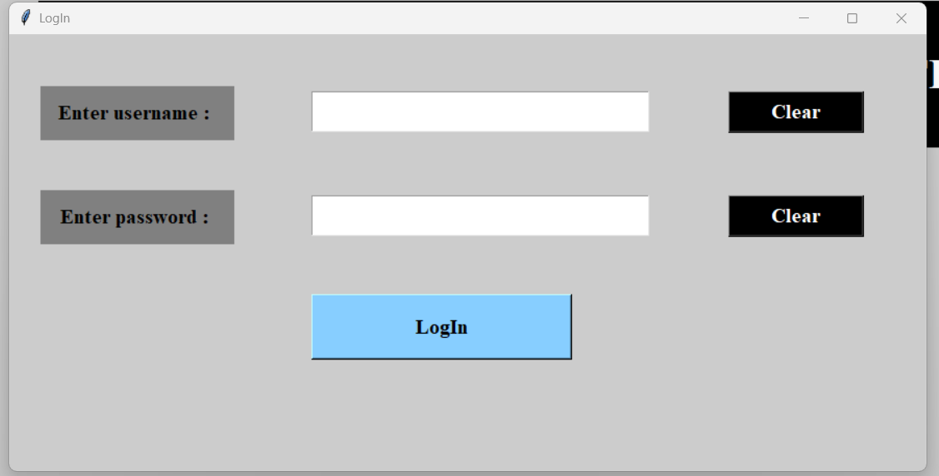
SUBJECTWISE ATTENDANCE PANEL
ADMIN PANEL

Slide 16
Conclusion
In this system we have implemented an Face ID attendance system for a lecture, section or laboratory by which lecturer or teaching assistant can record students’ attendance. It will save time and effort, especially if it is a lecture with huge number of students. Face ID Attendance System has been envisioned for reducing the drawbacks in the traditional (manual) system. This attendance system demonstrates the use of image processing techniques in classroom. This system can not only merely help in the attendance system, but also improve the goodwill of an institution.

Slide 17
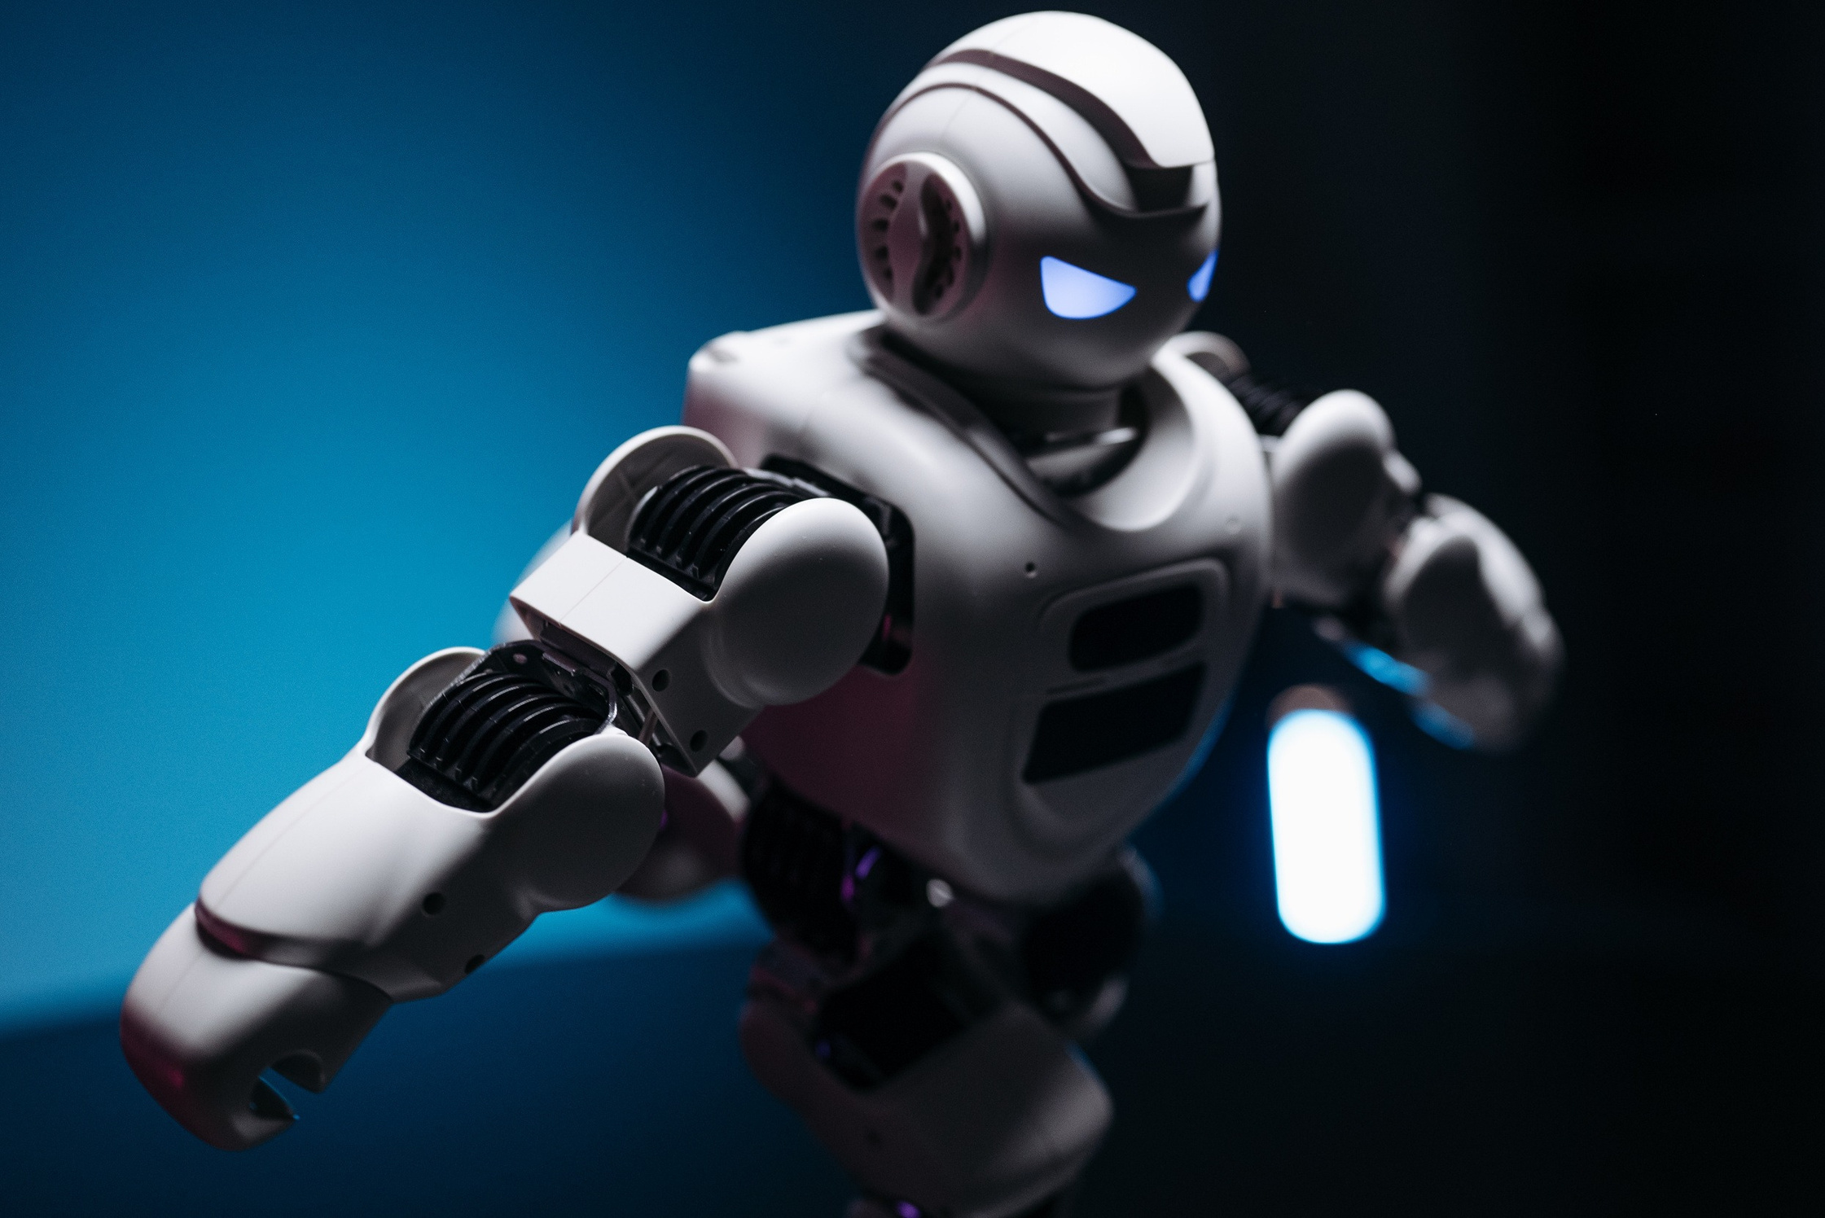

References
[1] A Kumar, B Ram. “RFID and pose invariant face verification based automated classroom attendance system [C]”, International Conference on Microelectronics, Computing and Communications. IEEE, 2016, Pg. 1-6.
[2] R. Kaur, M. Sharma “Combination of RFID and face recognition for access control system [C]”, IEEE International Conference on Consumer Electronics - Taiwan. IEEE, 2015, Pg. 470 471.
[3] S. Patel, N. Mehta , “University Y. Convolutional Neural Network-Based Video Face Detection and Recognition [J]”. Computer Knowledge & Technology, 2018, Pg. 420-436
[4] T. Singh, L. Kumar. “Continuous Real-Time Vehicle Driver Authentication Using Convolutional Neural Network Based Face Recognition [C]”, IEEE International Conference on Automatic Face & Gesture Recognition. IEEE, 2018, Pg. 577-584.
[5] P. Sharma, V.S. Joshi. “A review of convolutional neural networks[J]”. Chinese Journal of Computers, 2017, 40(6) Pg. 1229-1251.

Slide 18
[6] A.K. Verma, P. Jain , Automatic Face Recognition Attendance System using Python and OpenCV. [International Journal of Scientific Research in Computer Science, Engineering and Information Technology (IJSRCSEIT), 2019]. Utilizes machine learning for face recognition, improving accuracy and reducing manual effort, leveraging OpenCV for detection and employing HOG and SVM for name recognition.
[7] A. Mishra, K. Gupta. (Year). Efficient Cloud-Based Attendance Systems Using Face Recognition. [APA, IEEE]. Discusses cloud-based systems for managing attendance through facial recognition, focusing on data storage, processing, and security considerations.
[8] S. Goyal, M. Patel. Face Recognition Based Attendance System utilizing YOLOv5. [International Conference on Innovations in Information and Communication Technology (ICIICT)]. Focuses on automating the attendance process by leveraging YOLOv5 for real-time object detection, capturing live video feeds to detect and recognize students' faces for automatic attendance marking.
[9] R. Das, S. Saha. Face Recognition-Based Attendance System Using CNN and Transfer Learning. Explores an automated attendance system that employs CNNs and transfer learning to enhance face recognition performance against variations in facial expressions and orientations.
[10] S. Tripathi, D. Ghosh. Deep Learning-based Face Recognition. [IEEE Transactions on Pattern Analysis and Machine Intelligence]. Surveys the use of CNNs in face recognition tasks, discussing the improved accuracy of deep learning models compared to traditional approaches like Eigenfaces and Fisher faces.

Slide 19

Thank You!

